Slide 1
Optimizing Small Biopsies in Soft Tissue and Bone
Ancillary Studies
June 1st, 2024
Alessandra F. Nascimento, MD
Division Chief, Anatomic Pathology
Director, Bone and Soft Tissue Pathology
Associate Professor, Case Western Reserve University

Slide 2
Dr. Alessandra Nascimento declares she has no conflict(s) of interest to disclose
RDC Nº 96/08 da ANVISA

Slide 3
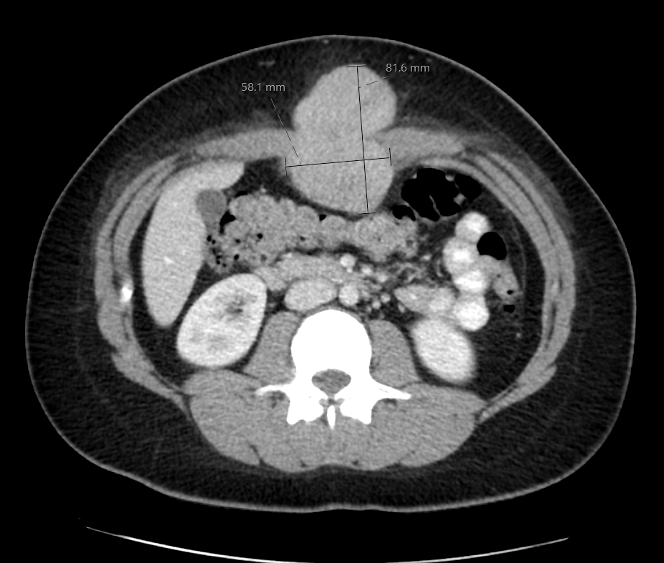
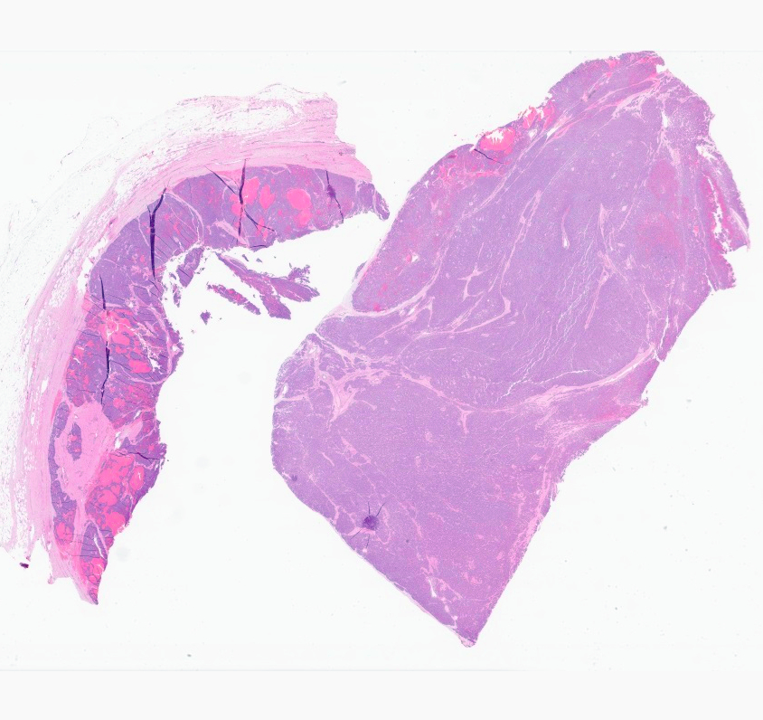
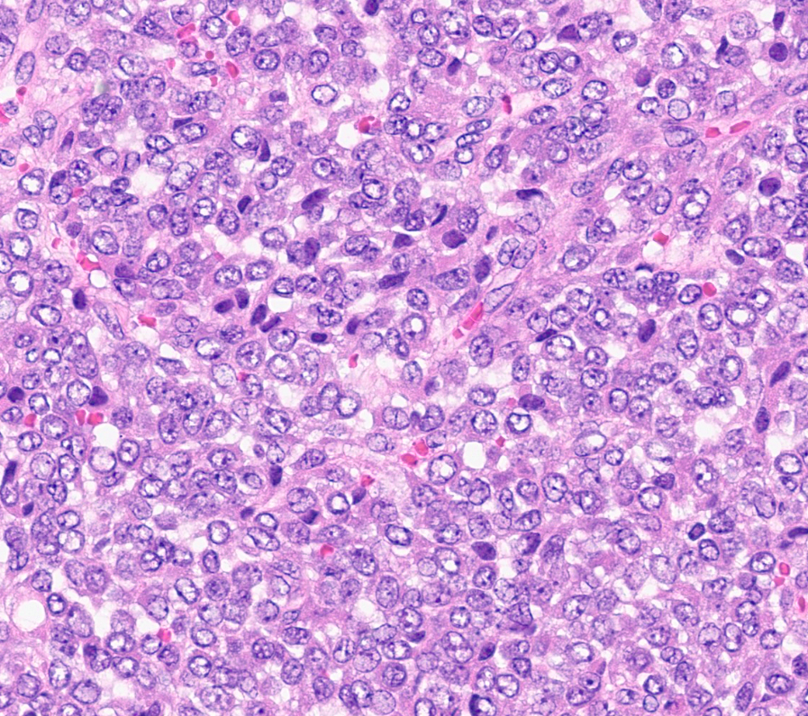
24 yo female; 2019 – abdominal wall mass
Notes:
While the prior case may not convince you of the need for a fusion panel, this one might… This is a case of a 24 yo female who comes to medical attention in 2019 for this large abdominal wall mass. The patient underwent a resection of this lesion. The tumor is composed of sheets of round monomorphic cells, with vesicular chromatin, small nucleoli and small amounts of cytoplasm.

Slide 4
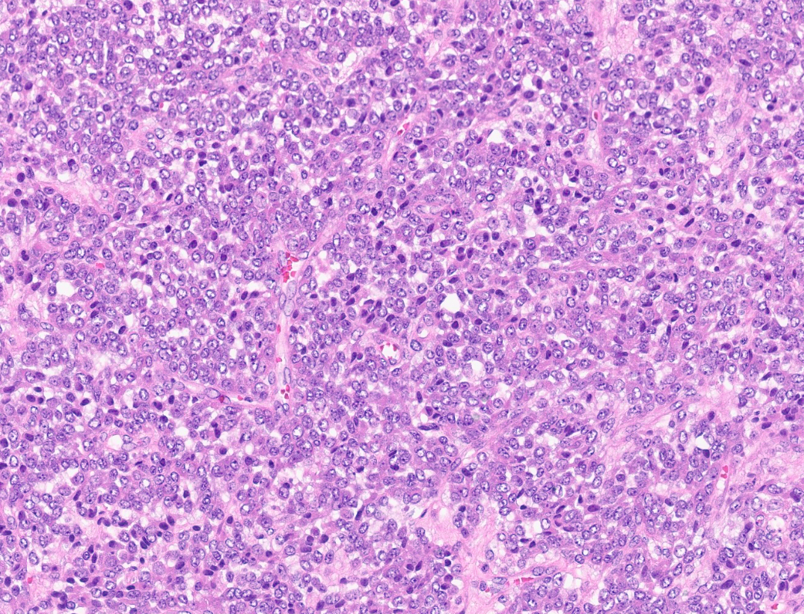
R0 resection: Well differentiated neuroendocrine tumor
  INSM1 and synaptophysin
June 2020: recurrence – diagnosed as Poorly differentiated small round cell tumor
6 cycles of VAC/IE + XRT + surgery
  Near complete response
September 2023: Scalp and brain metastases
Biopsy showing same morphology
Notes:
The excision was considered a complete resection. The tumor was positive for INSM1 and synaptophysin and was signed out as a well differentiated neuroendocrine tumor. In June of 2020 this young lady developed a local recurrence which was diagnosed as a poorly differentiated small round cell tumor. She underwent 6 cycles of Ewing sarcoma chemotherapy protocol, followed by radiation and surgery. The lesion showed nearly complete pathologic response. In September of 2023 new scalp and brain mets were diagnosed. The morphology of the metastasis is shown here and is very similar to the initial tumor.

Slide 5
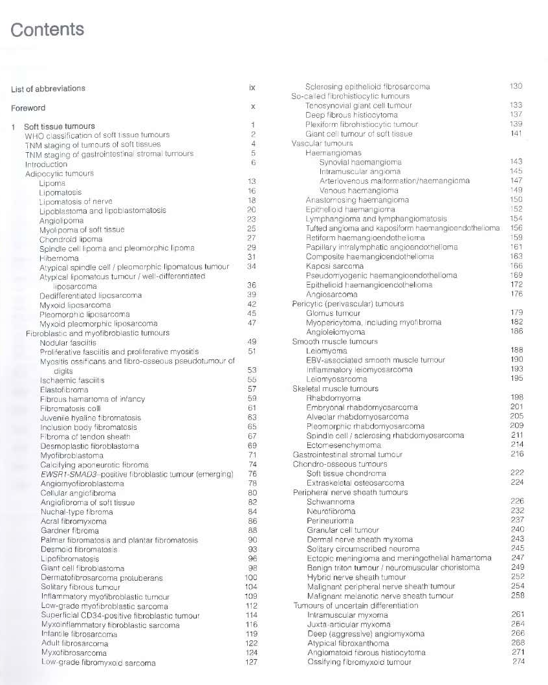
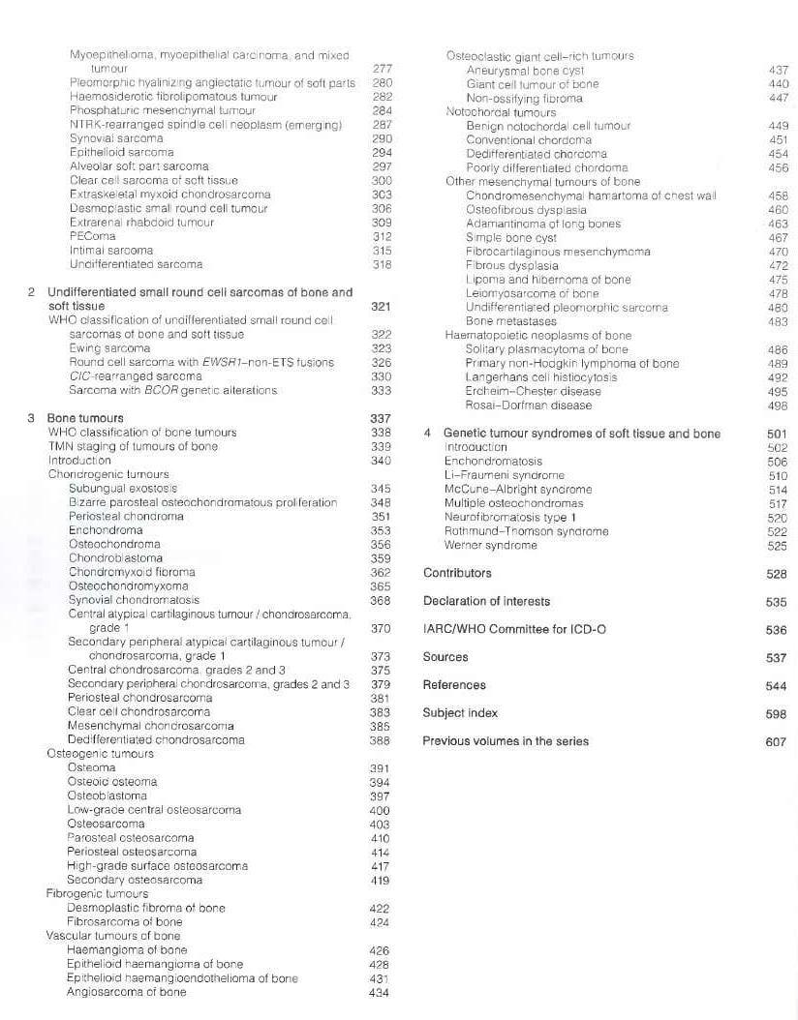
Introduction
> 100 mesenchymal neoplasms of soft tissue and bone
ST sarcomas account for < 1% of all malignant tumors; bone sarcomas correspond to 0.2% of all neoplasms
WHO Classification is based on lineage
  Lineage may not be obvious or maybe unknown
  Tumors of different lineages may have overlapping histologic appearances

Slide 6
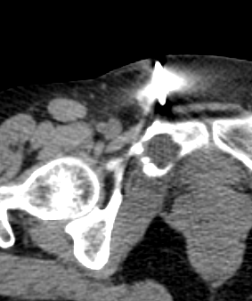
Biopsy of a Musculoskeletal Lesion
Pivotal step in the management of musculoskeletal tumors
Cognitive event
  Input from surgeon, radiologist and pathologist is vital for success
Accurate diagnosis:
  Facilitates treatment decisions
  Determines prognosis

Slide 7
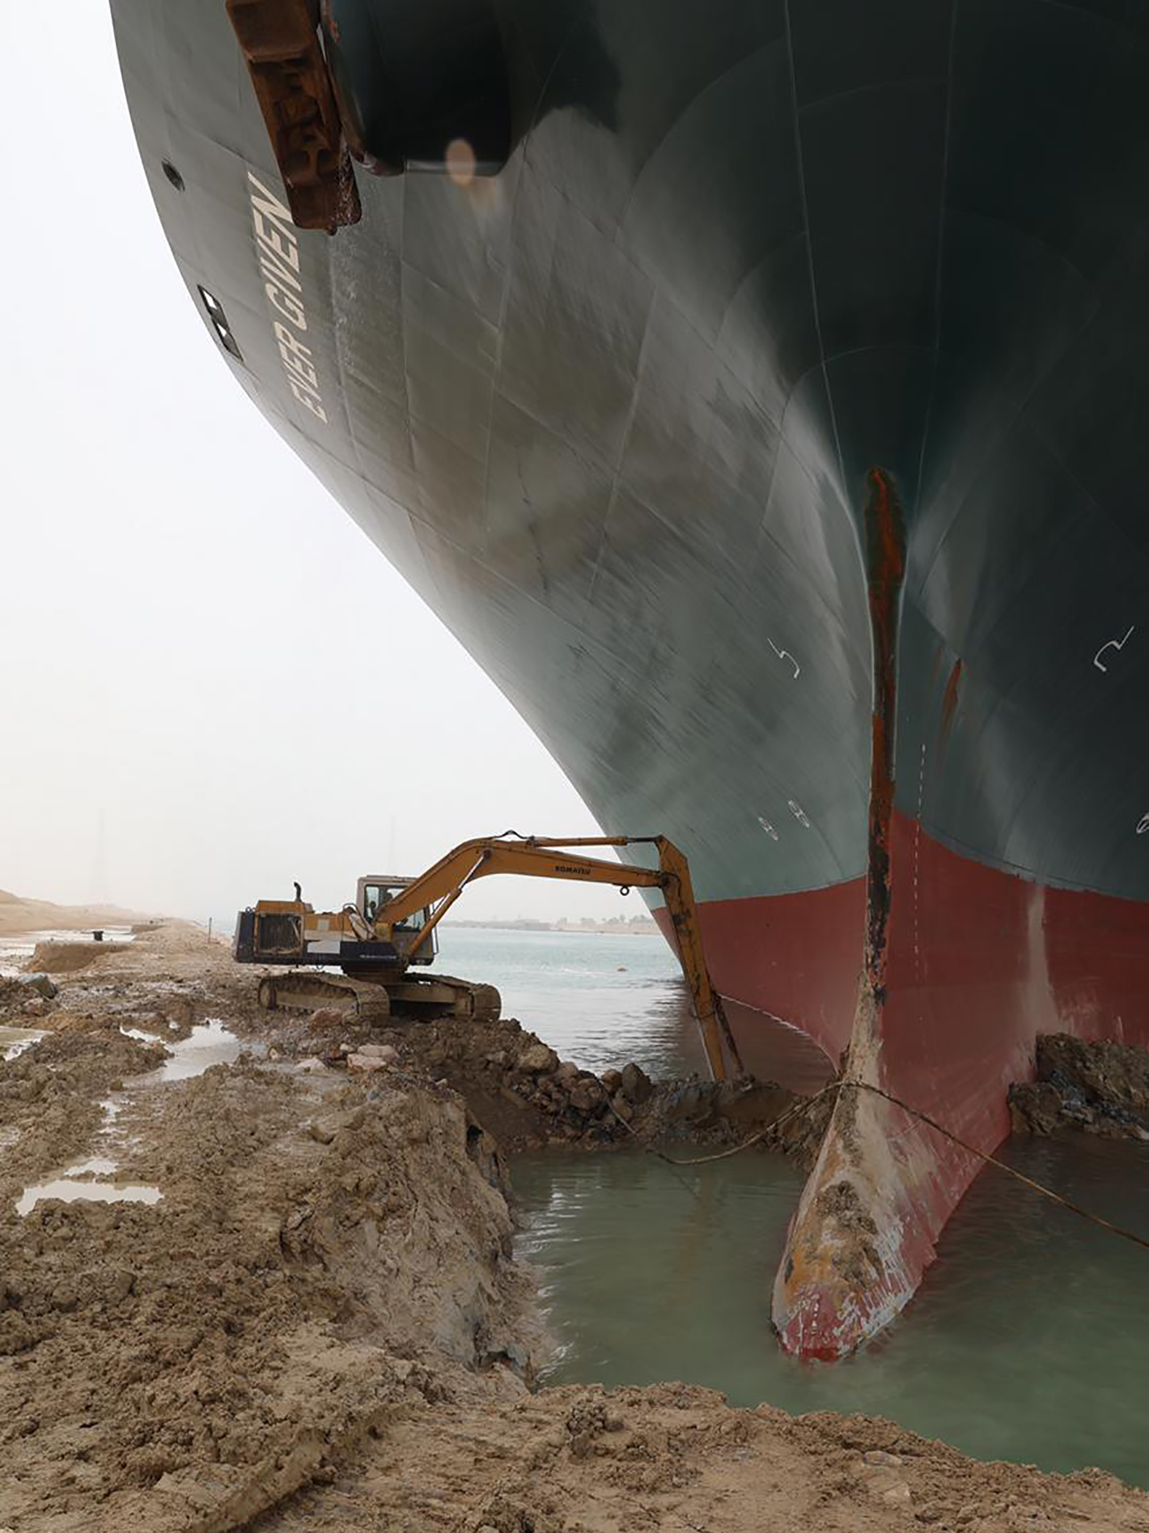
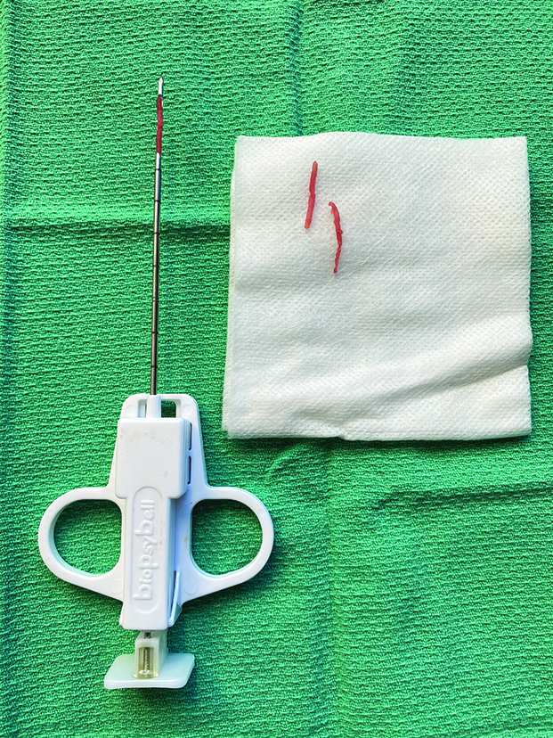
TUMOR
Core Needle Biopsy

Slide 8
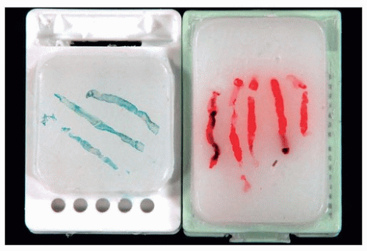
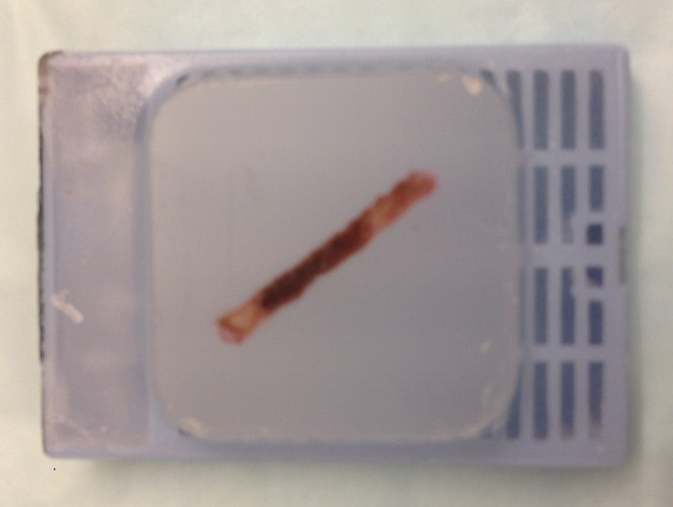

Slide 9
Decalcification Technique and Ancillary Testing
Decalcification solution | IHC | Molecular testing
None | N/A | N/A
Acid decalcification | Some antibodies are affected | Cannot be performed
EDTA | Little to no effect on immunoreactivity | All molecular testing (FISH, NGS) possible

Slide 10
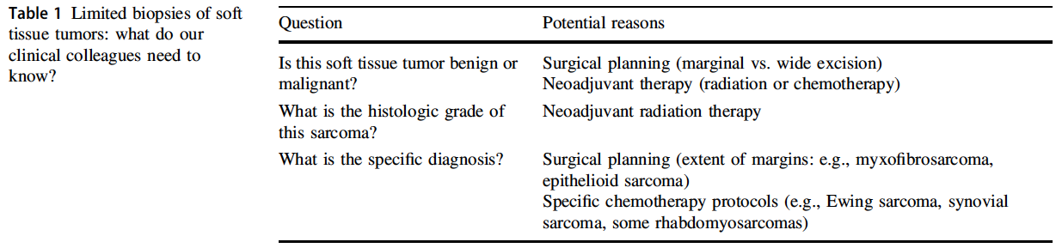
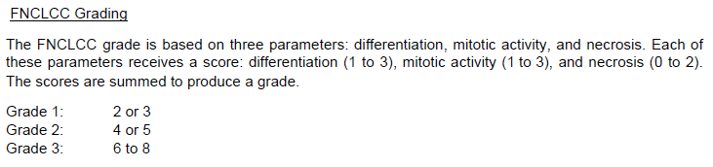
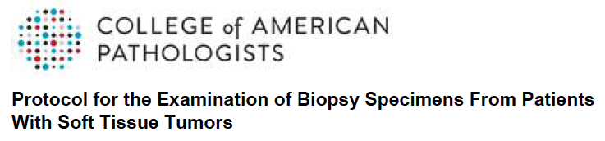

Slide 11


Slide 12
Immunohistochemistry
Wide availability
Rapid turnaround time
Cheap
Interobserver reproducibility
“Generic IHC” is often insufficient for diagnosis in soft tissue pathology
  CD34, SMA, desmin
Sensitivity and specificity
Antibodies
ALK | FOSB | RB1
𝛽-catenin | H3K27me3 | ROS1
BCOR | MDM2 | SDHB
CAMTA1 | MUC4 | SMARCA4
CCNB3 | MYC | SMARCB1
CDK4 | NKX2-2 | TFE3
DOG1 | PAX3 | TLE1
ETV4 | PDGFRA | TRK
SS18-SSX fusion AB (E9X9V) and SSX-specific AB (E5A2C)
H3 G34W | H3 K36M | SATB2

Slide 13
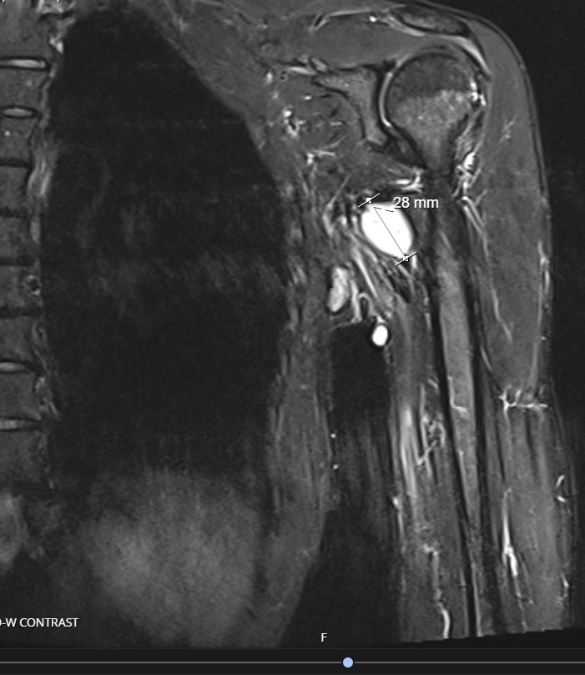
Case #1
52 yo female with a recent diagnosis of invasive ductal carcinoma of the breast
New axillary node
  3 cm mobile nodule in axillary fold
Main differential diagnosis
  Metastatic carcinoma

Slide 14
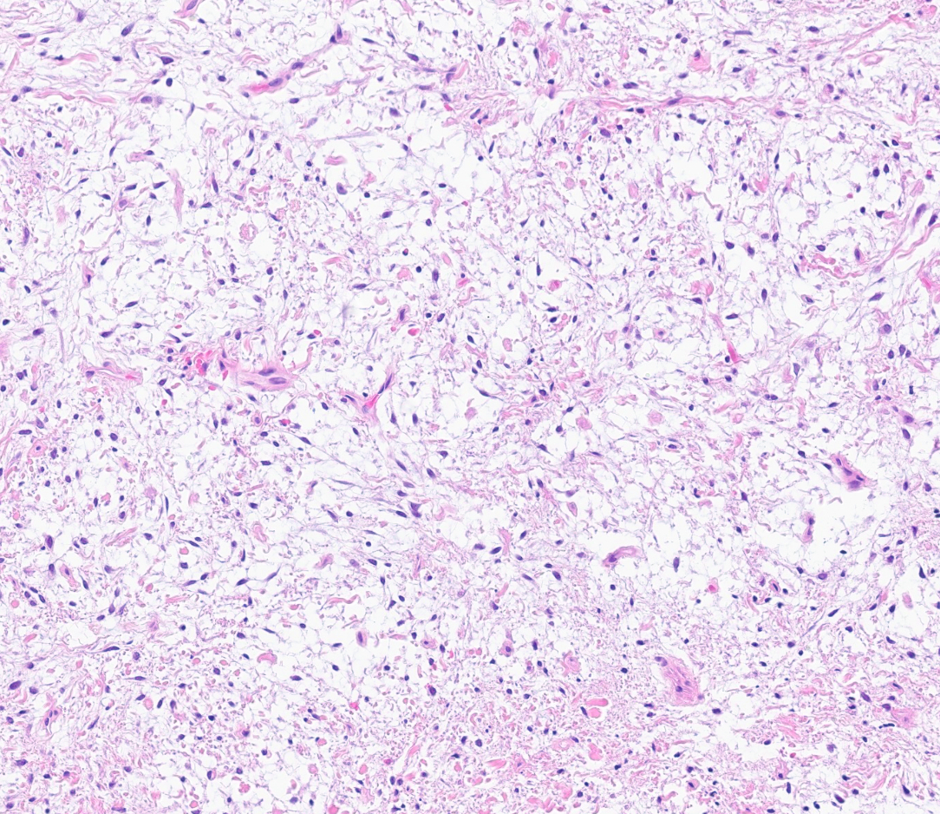
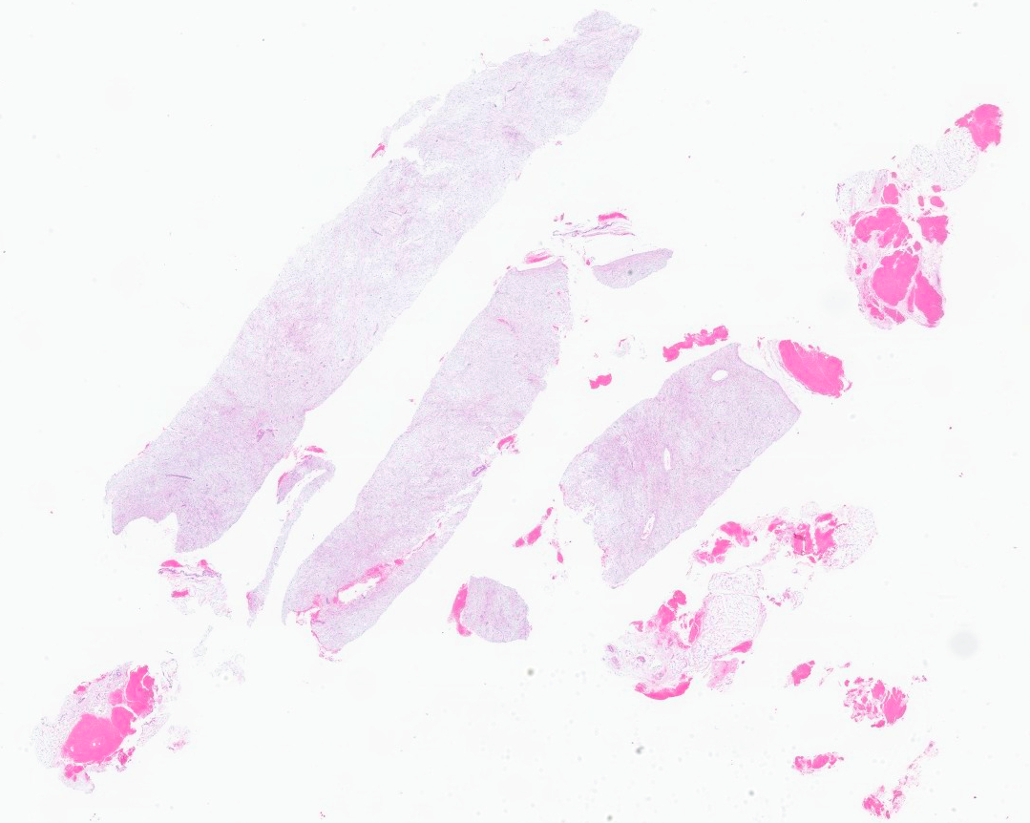
Left axillary lymph node, biopsy:
-- LOW GRADE MYXOID NEOPLASM; SEE NOTE.
-- IHC: positive for CD34, and negative for S100, CK7, desmin, SOX10, CAM 5.2, EMA and AE1/AE3

Slide 15
Myxoid Tumors of Soft Tissue
Ganglion cyst
Intramuscular/cellular myxoma
Juxtaarticular myxoma
Dermal nerve sheath myxoma
Superficial acral fibromyxoma
Superficial angiomyxoma
Deep (“aggressive”) angiomyxoma
Myoepithelial tumors
Ossigying fibromyxoid tumor
Myxoinflammatory fibroblastic sarcoma
Myxofibrosarcoma
Myxoid liposarcoma
Extraskeletal myxoid chondrosarcoma
LG fibromyxoid sarcoma
Other Tumors with myxoid stroma
  Myxoid nodular fasciitis
  Myxoid nerve sheath tumors
  Myxoid DFSP
  Myxoid SFT
  Myxoid synovial sarcoma
Depth of location
Extent of the myxoid stroma
Presence/absence of pleomorphism
Presence of distinctive vasculature

Slide 16
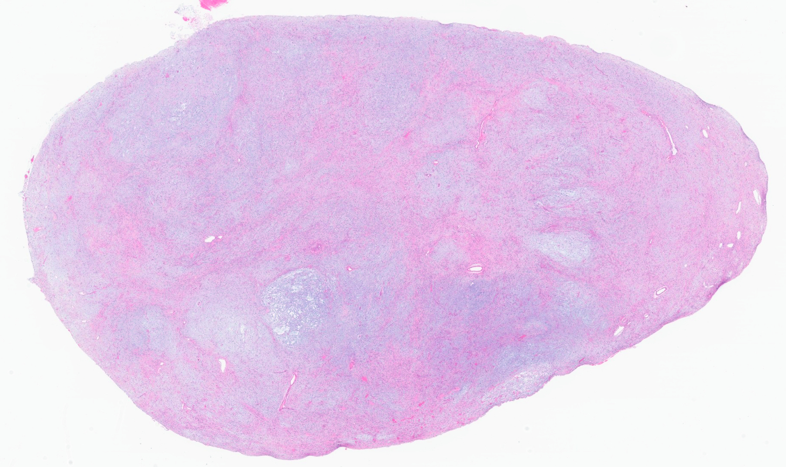
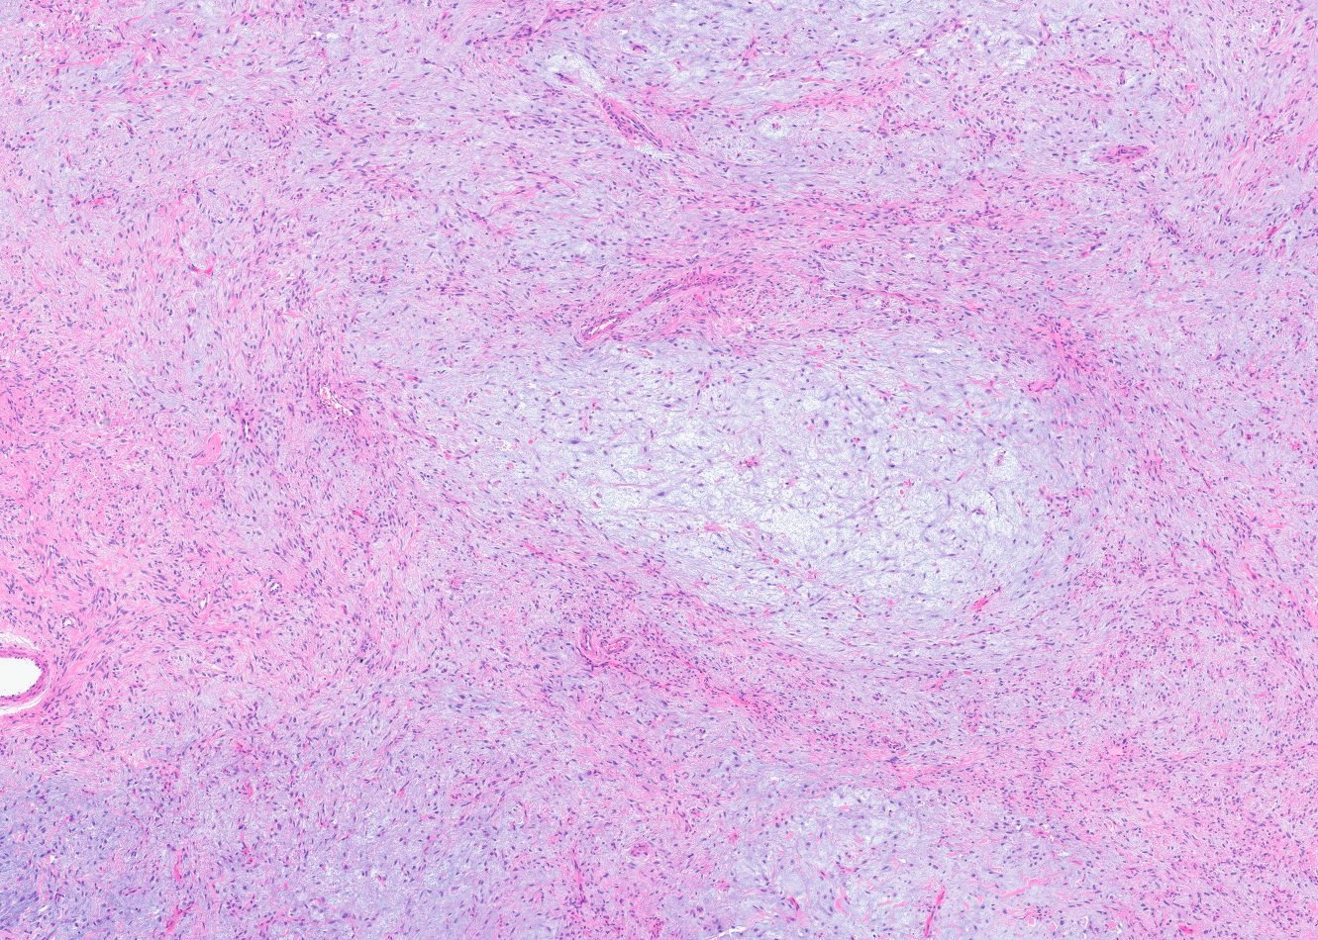

Slide 17
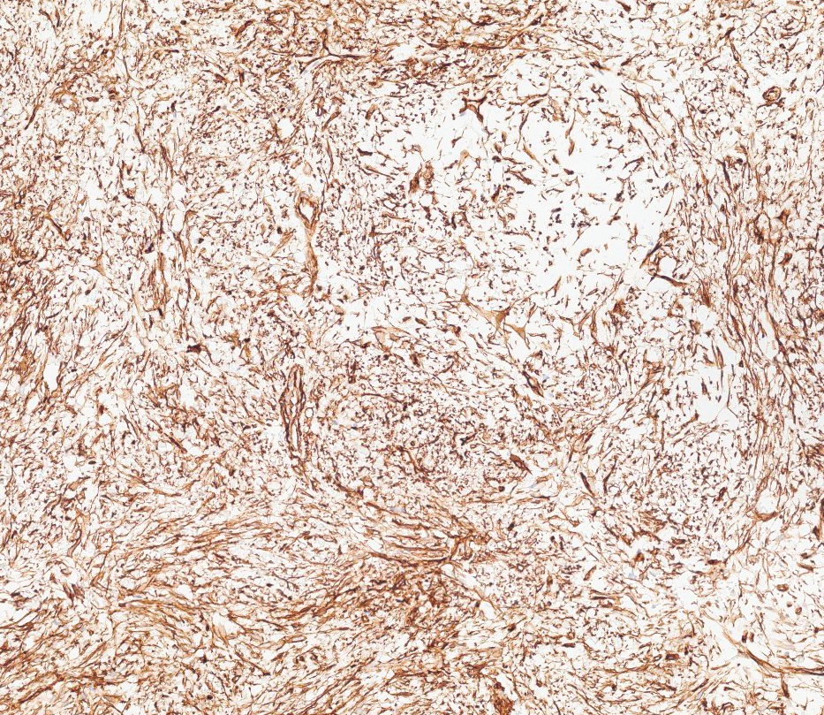
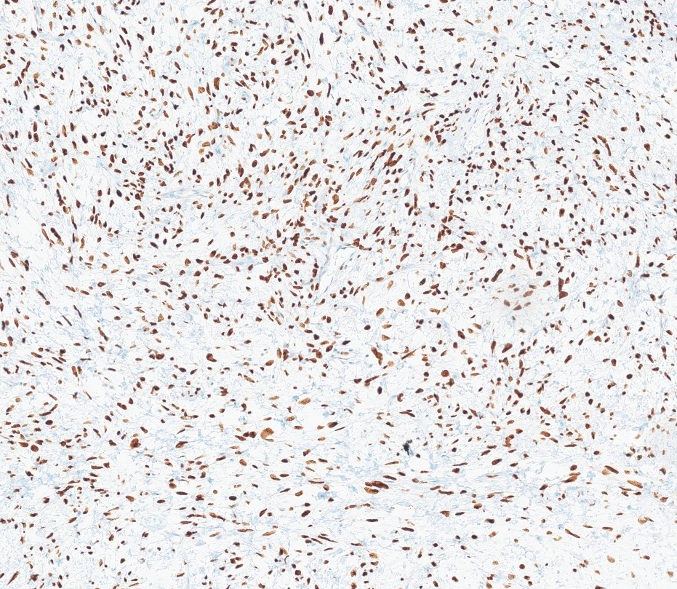
CD34
STAT6
Left axillary mass, excision:
-- SOLITARY FIBROUS TUMOR (2.6 CM), LOW RISK, WITH SUBTOTAL MYXOID STROMA
-- IHC: positive for CD34 and STAT6
-- Sarcoma fusion NGS demonstrated NAB2::STAT6 fusion

Slide 18
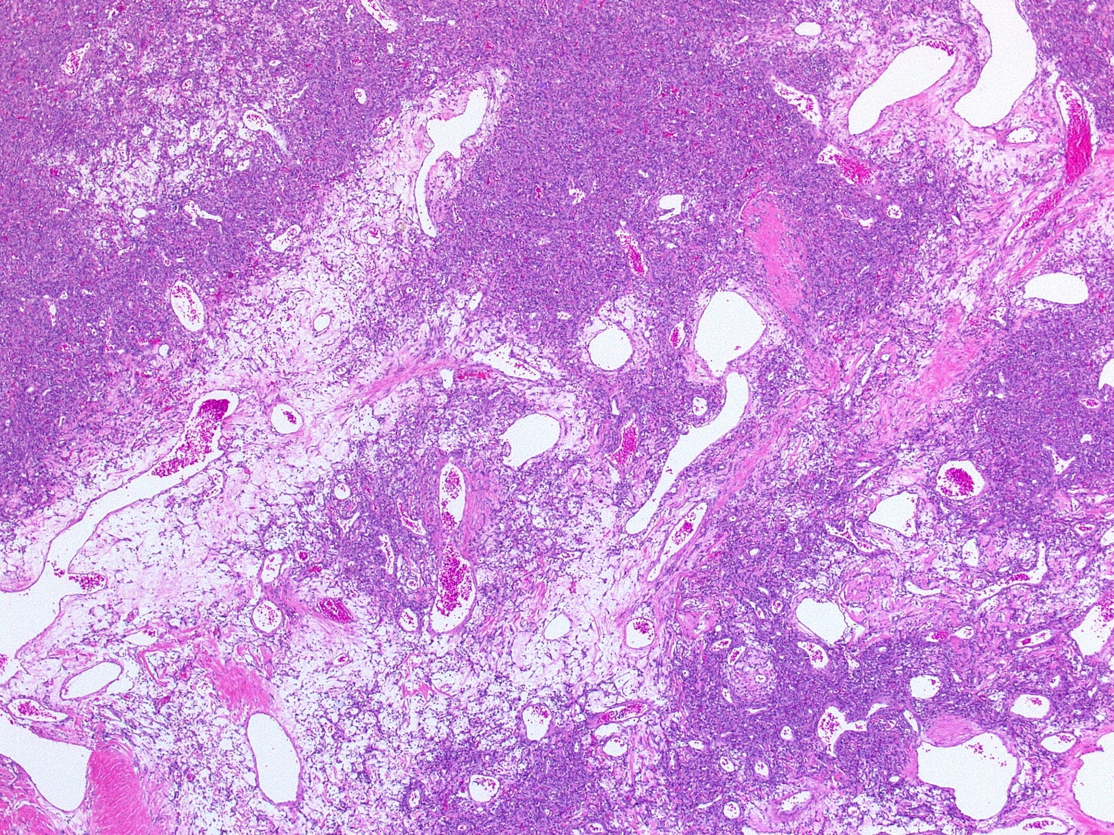
Solitary Fibrous Tumor
Anatomically ubiquitous fibroblastic neoplasm
  70-90% are deeply located
Men and women; adults
Distinct morphology
CD34 positivity in 95% case
Variants:
  Fat-forming, giant cell-rich, dedifferentiated SFT

Slide 19
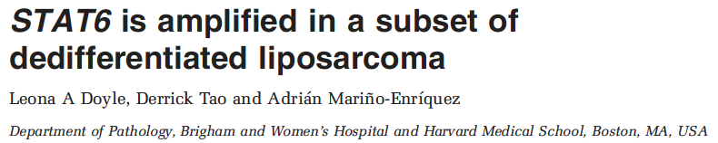
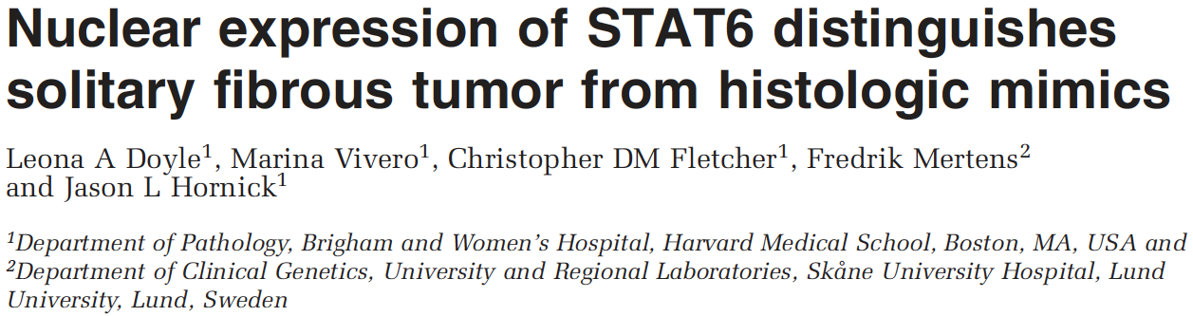
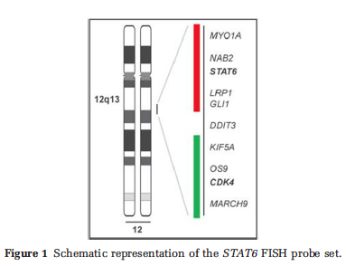
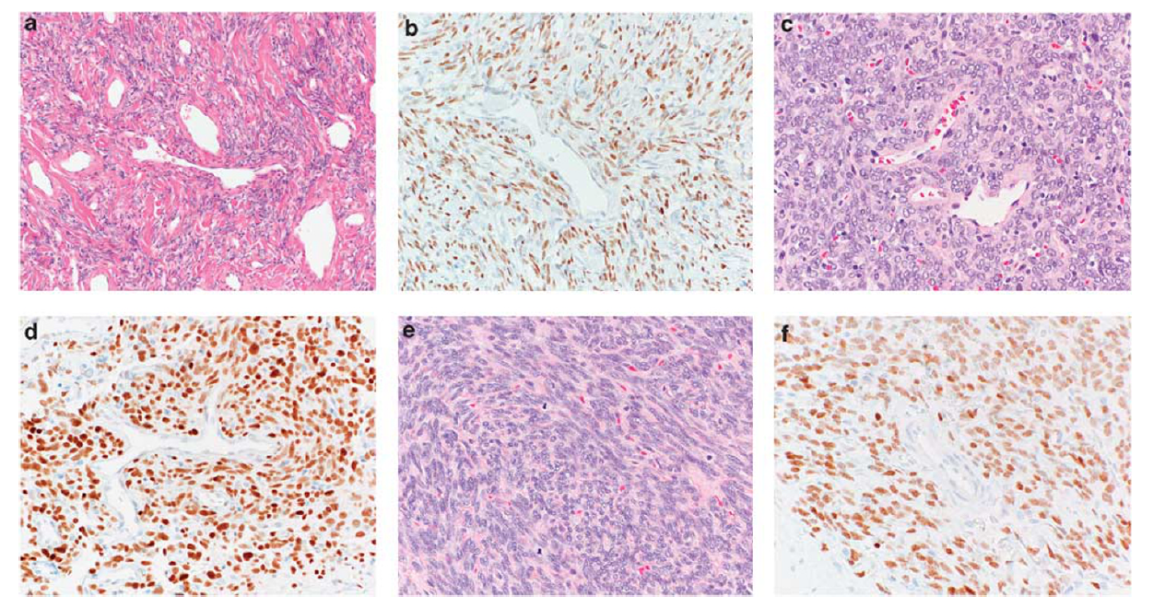
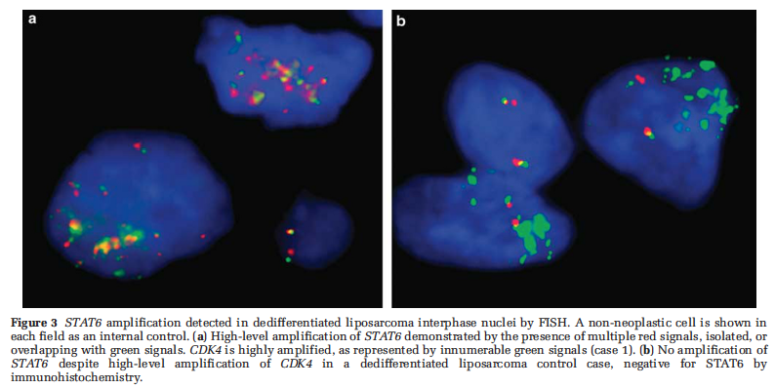
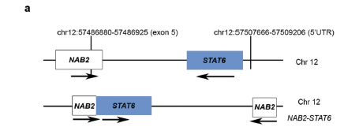
Solitary Fibrous Tumor

Slide 20
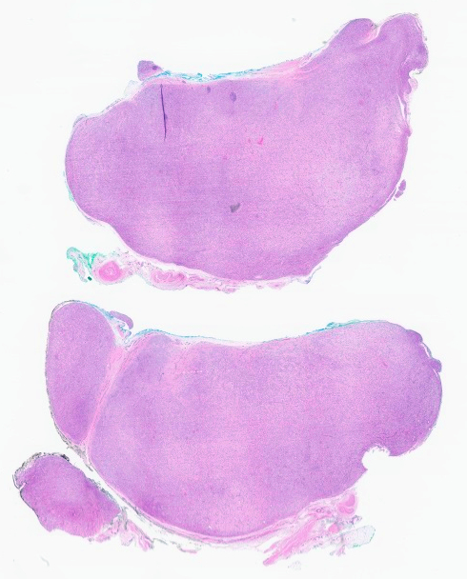
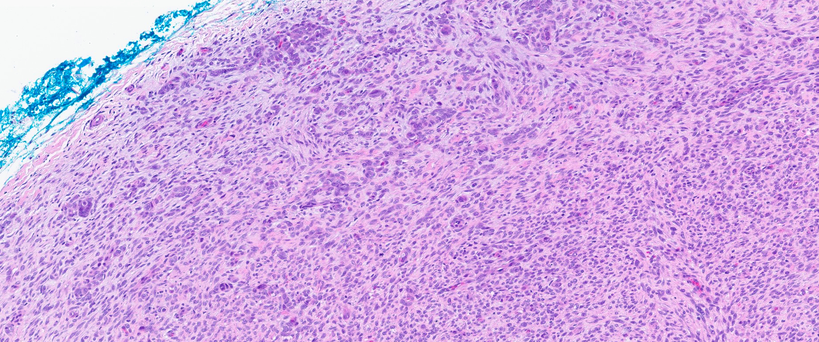
Case #2
70 yo female with a lump on the 2nd right toe

Slide 21
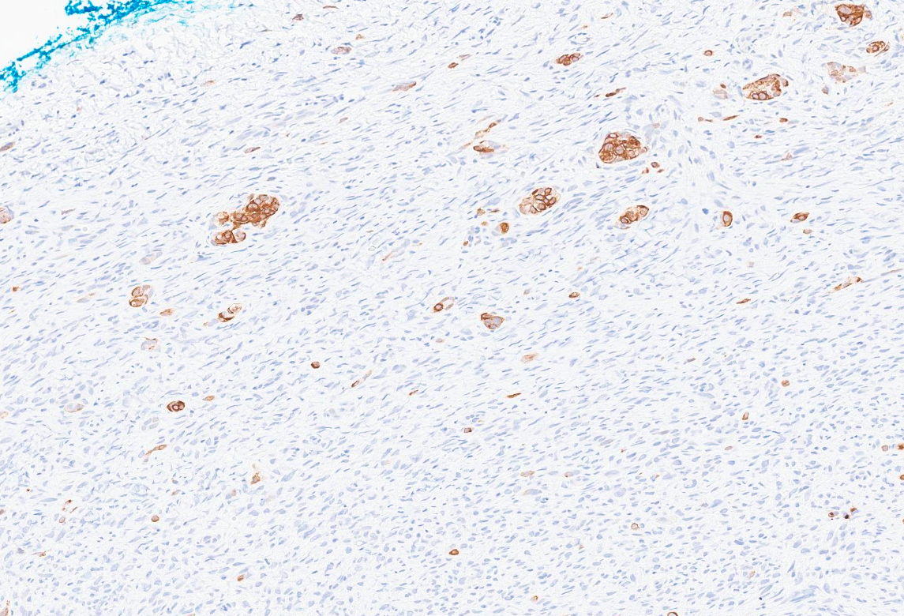
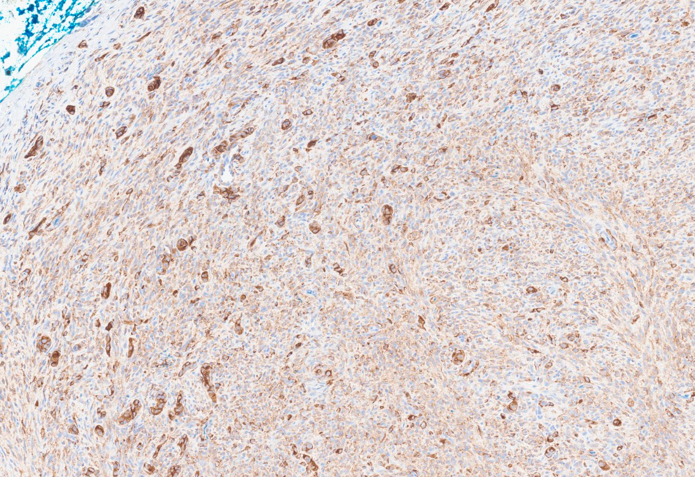
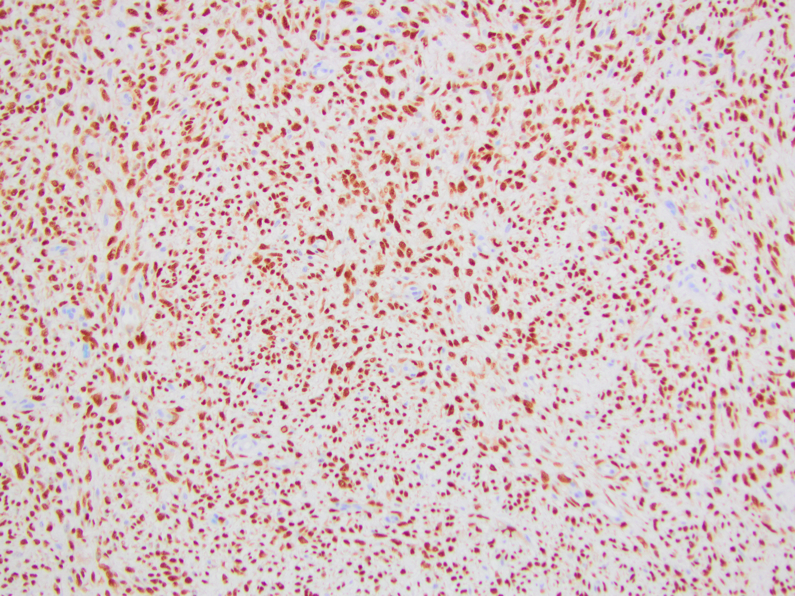
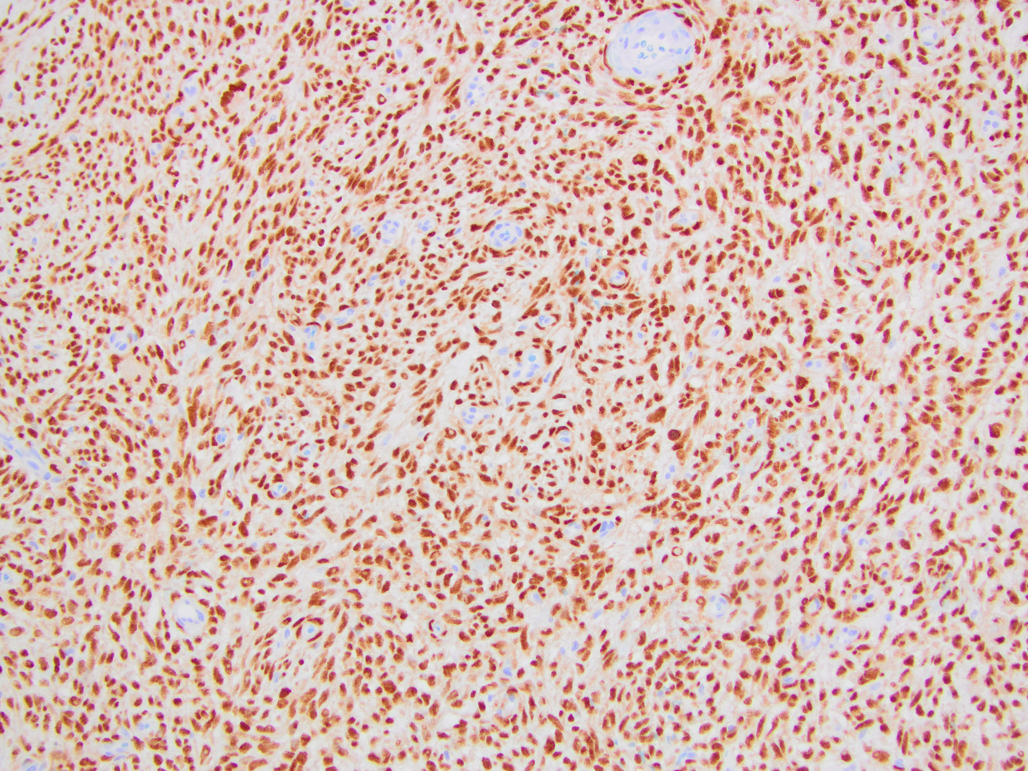
AE1/AE3
EMA
SS18-SSX
SSX

Slide 22
Synovial Sarcoma
Sarcoma with variable epithelial differentiation
10% of all soft tissue sarcomas and 2nd most common pediatric sarcoma
Deep soft tissues of extremities, often juxta-articular
More common in adolescents or young adults; M = F
  Peak incidence = 3rd decade; affects all ages
Aggressive sarcoma
  5- and 10-year survival = 60-80% and 50-75%, respectively

Slide 23
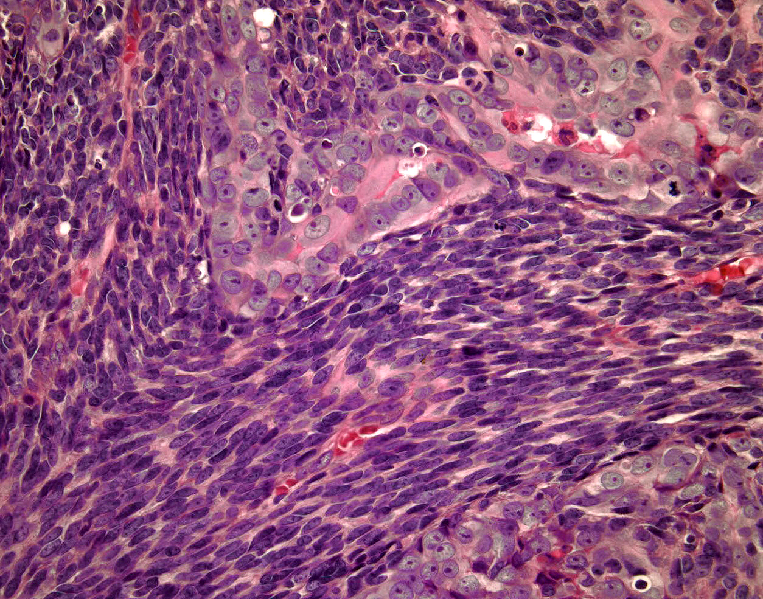
Synovial Sarcoma
3 dominant histologic subtypes
  Monophasic, biphasic and poorly differentiated
Differential diagnosis
  SFT, MPNST, round cell sarcomas
Immunohistochemistry
  Keratins and EMA
  CD99, S100, bcl2
Courtesy Dr. J. Reith

Slide 24
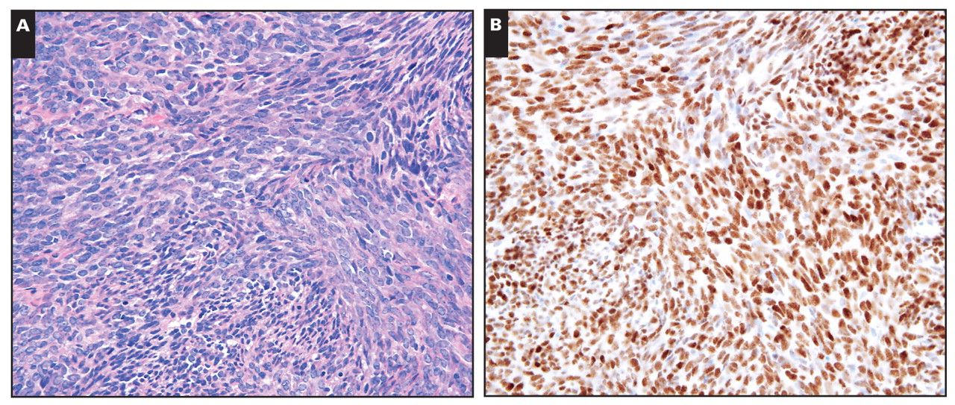
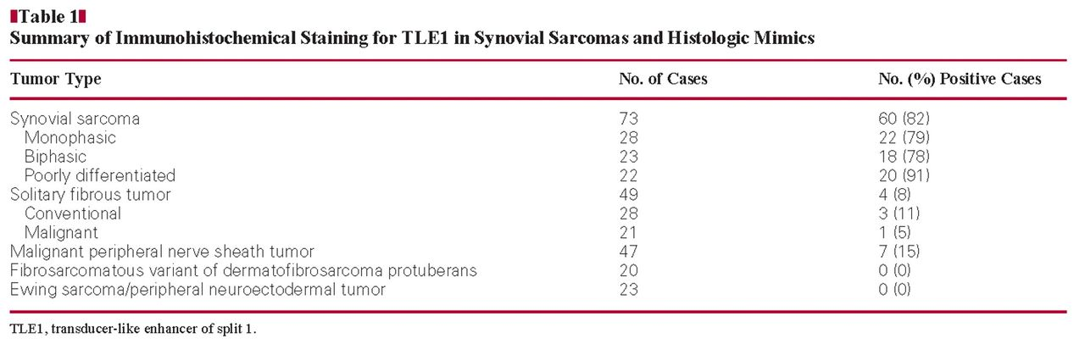

Slide 25
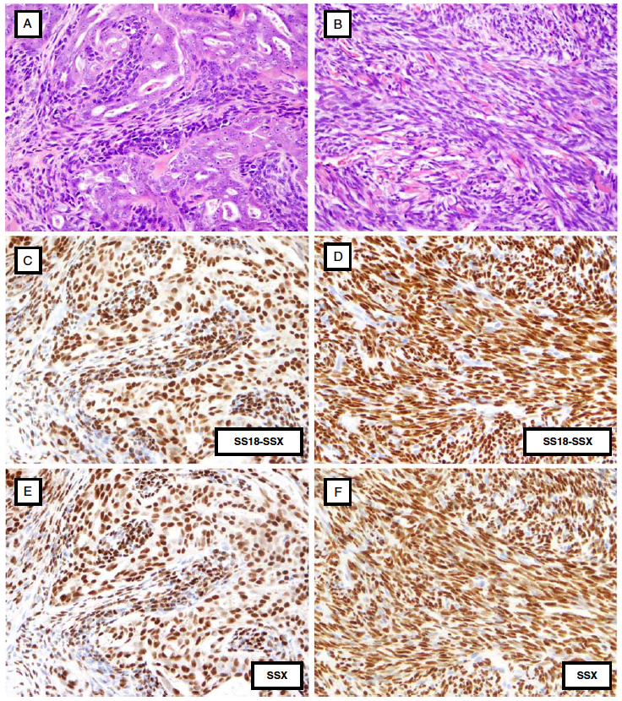
Defined by the hallmark
translocation t(X;18)(p11;q11)
Fusion of the SS18 gene
with one of the SSX genes
(SSX1, SSX2 or SSX4)
Identification of the fusion by
cytogenetics, FISH, RT-PCR or NGS
2 novel monoclonal Ab
Antibodies | Sensitivity | Specificity
SS18-SSX fusion | 95% | 100%
SSX C-terminus | 100% | 96%

Slide 26
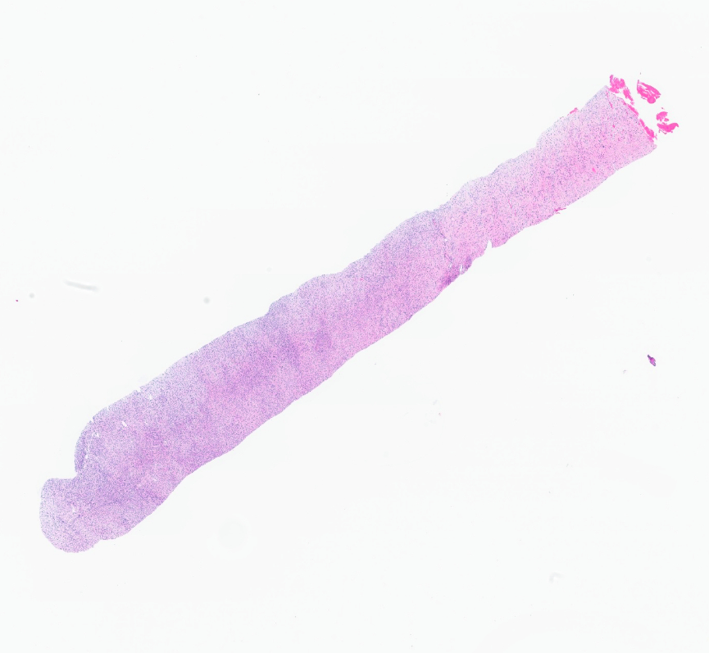
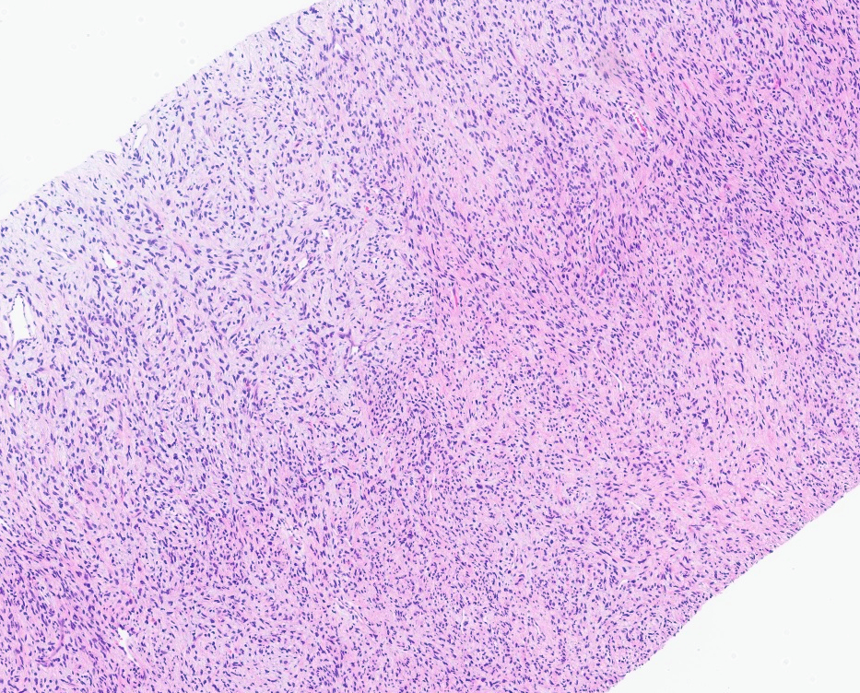
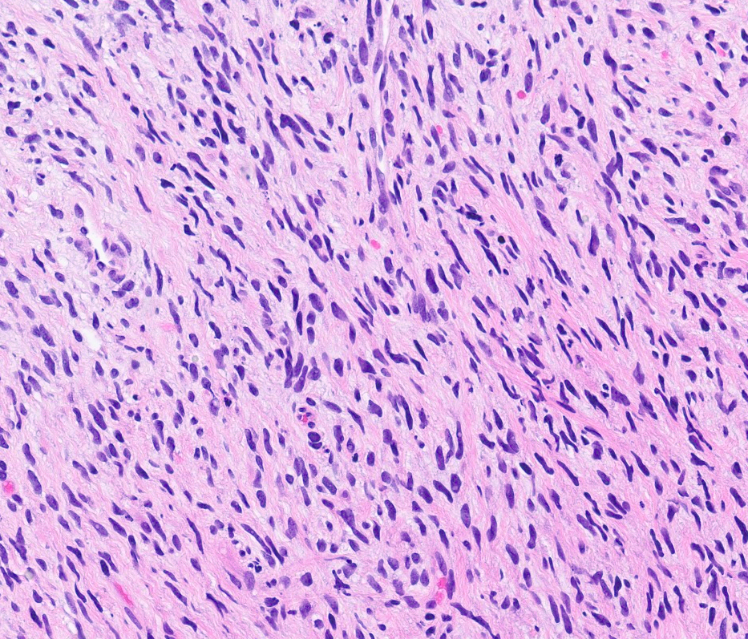
Case #3
15-year-old male; paraspinal mass

Slide 27
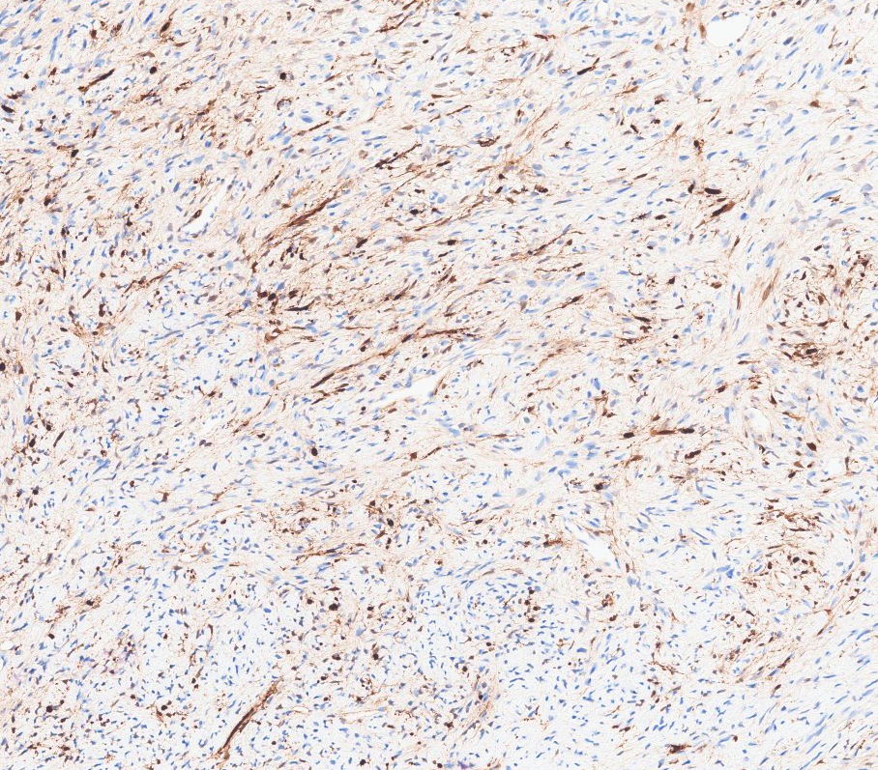
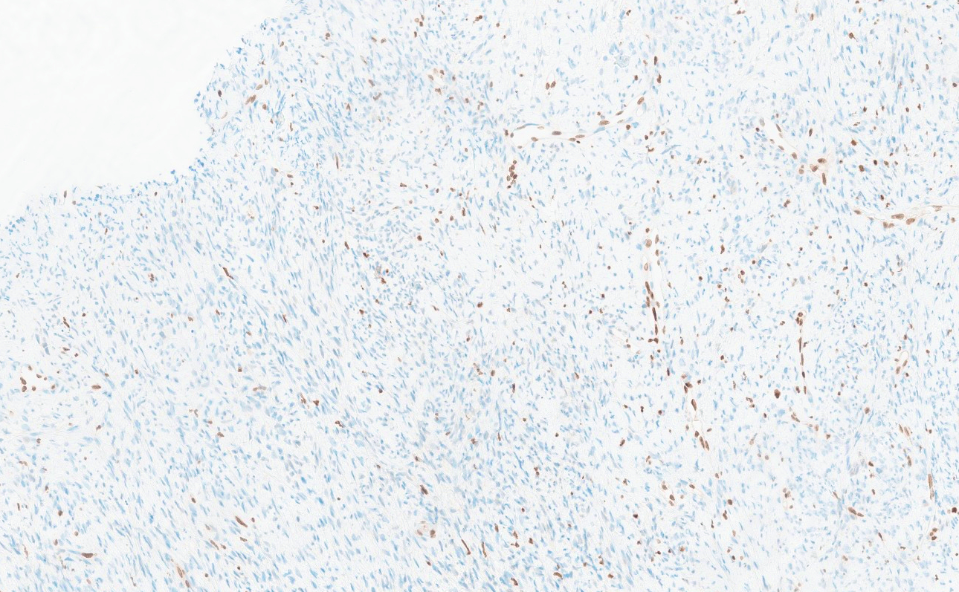
S100
H3K27me3
Paraspinal mass, biopsy:
-- MALIGNANT PERIPHERAL NERVE SHEATH TUMOR

Slide 28
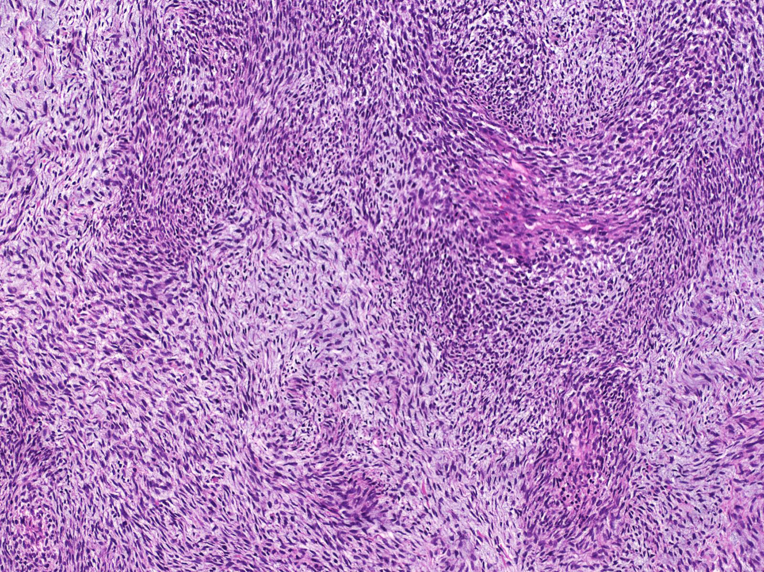
Malignant Peripheral Nerve Sheath
Patients with neurofibromatosis type 1, sporadically or following radiation therapy
Characteristic histologic features
  Alternating cellularity
  Perivascular accentuation
  Tapering nuclei
  Heterologous differentiation
Evidence of Schwann cell differentiation (S100 or SOX10) in <50% cases

Slide 29
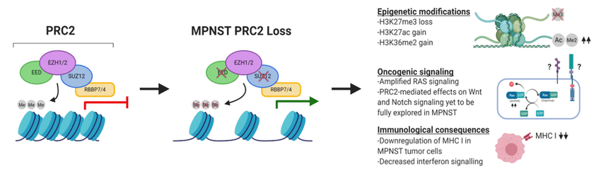
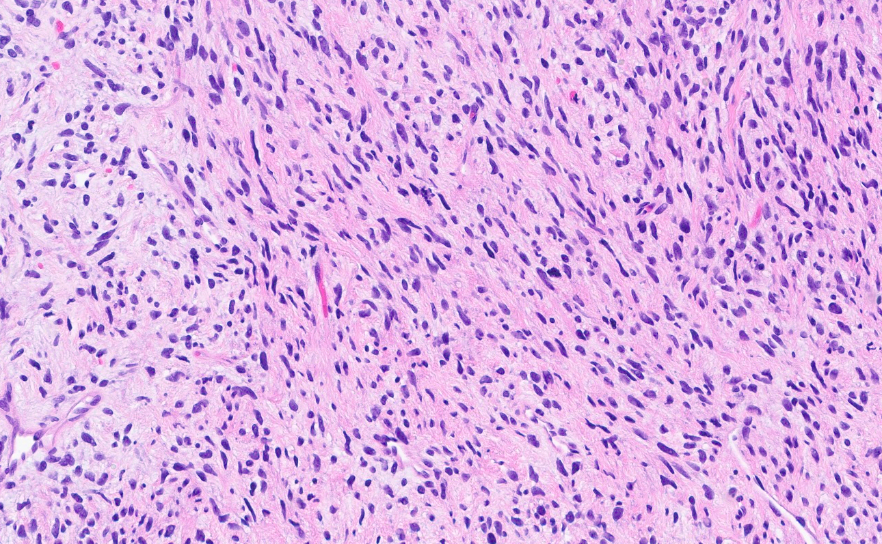
H3K27me3

Slide 30
Loss of H3K27me3
In MPNST, depends on tumor grade:
  High grade → 85% of cases
  Low grade → 35% of cases
Most sensitive and specific available marker for MPNST
Not entirely specific:
  May be loss in a small subset of dedifferentiated liposarcomas and spindle cell melanomas

Slide 31
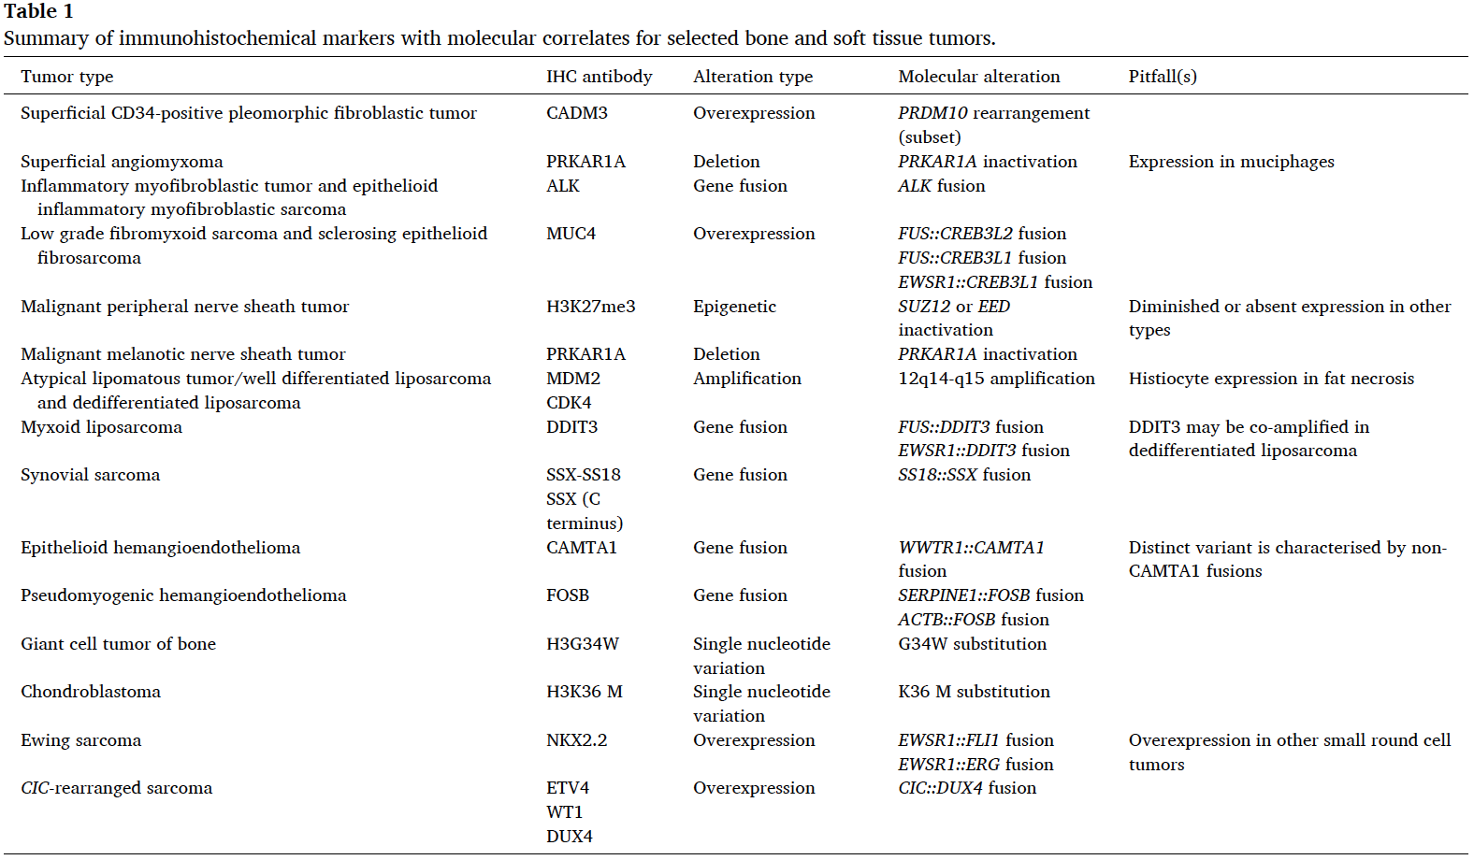
Conclusion I
Appropriate tissue handling can “make it or break it”
Specific diagnosis for soft tissue tumors may be challenging in small biopsies
  Impacts of appropriate surgery or neoadjuvant therapy
  At least grading should be attempted
IHC is cheap, widely available and reproducible
Many new antibodies are available and serve as surrogate marker of specific molecular abnormalities
  Variable sensitivity and specificity

Slide 32
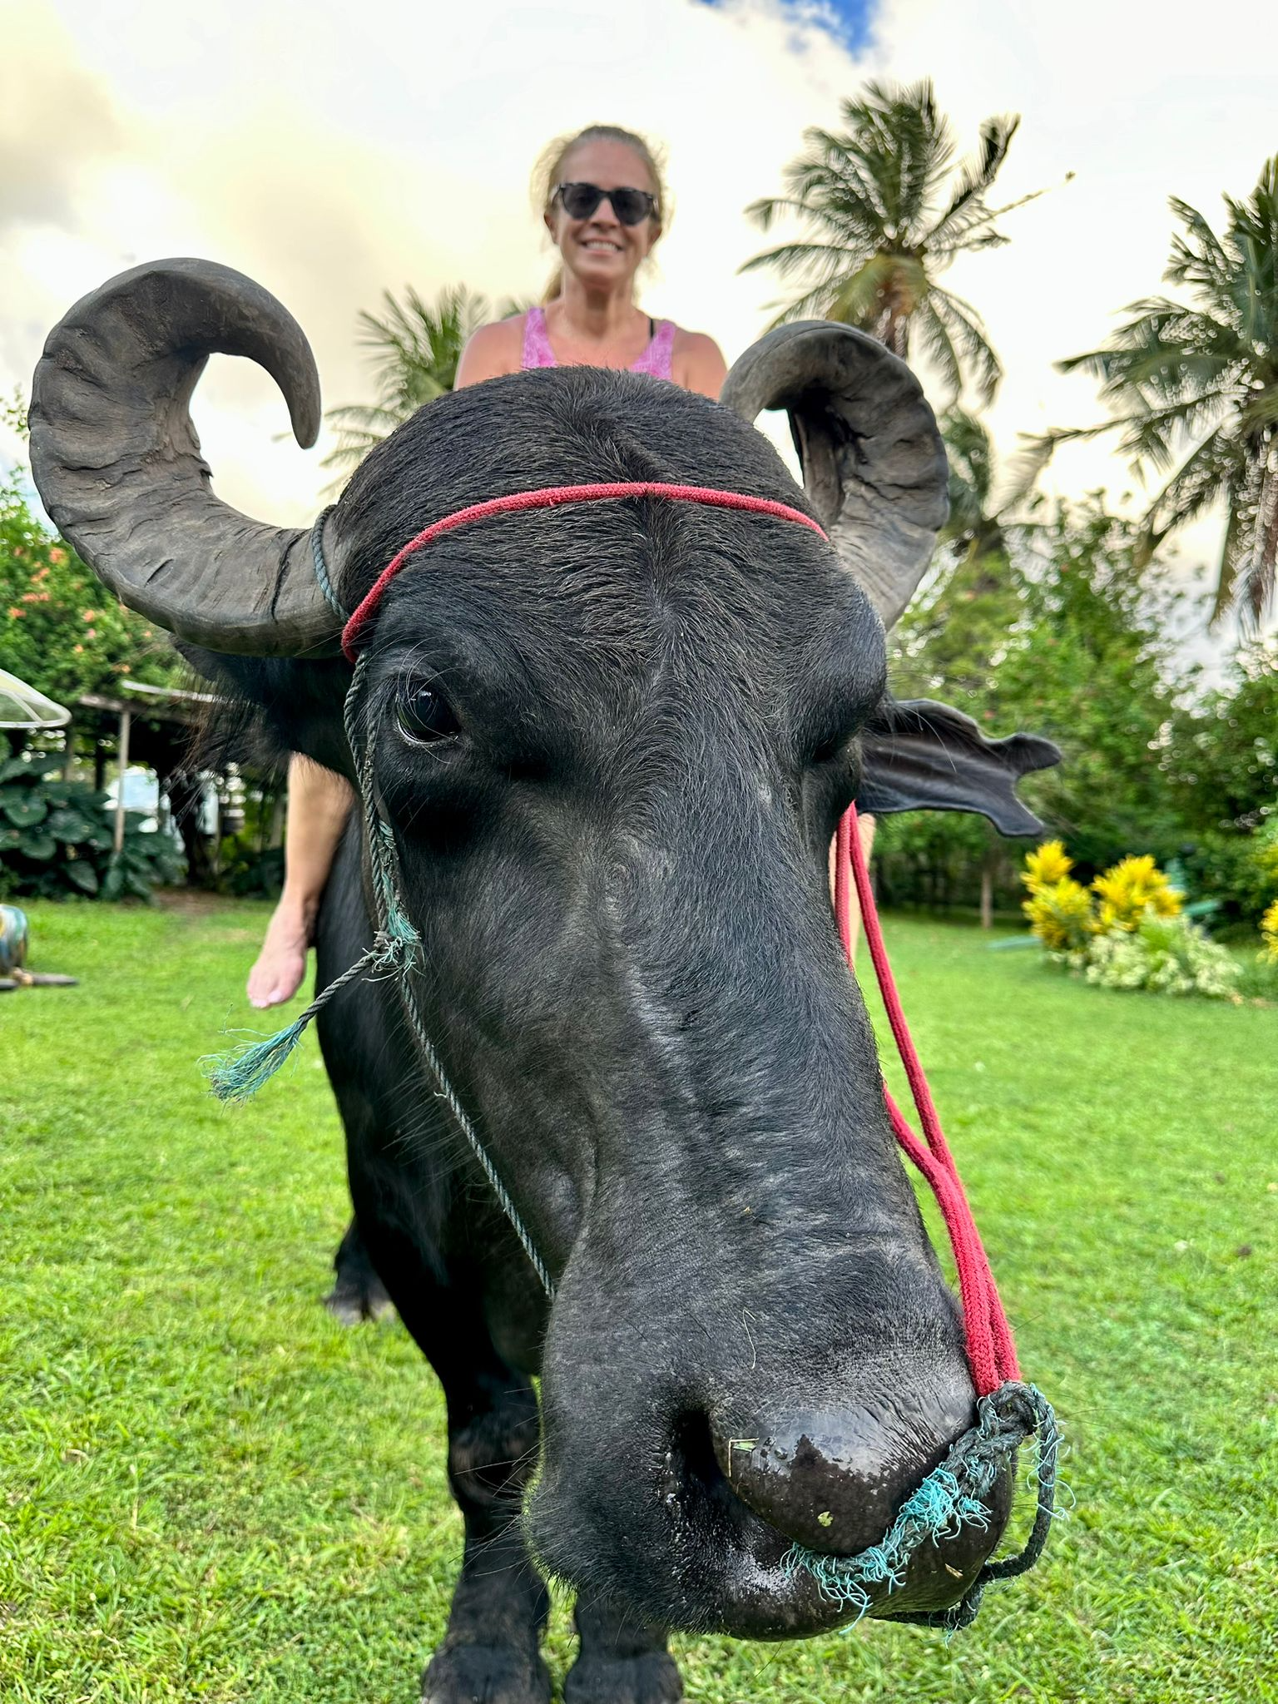

Slide 33
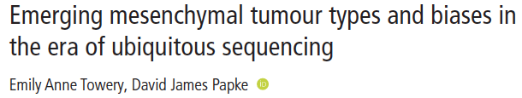
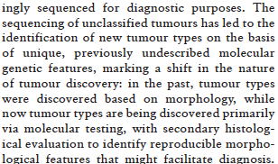
Molecular Genetics

Slide 34





Molecular Genetics
Several distinct techniques
  Conventional cytogenetics
  FISH
  RT-PCR
  NGS
  Multiplex gene fusion assays
Expensive
Time consuming
Not widely available
Cannot be performed in all decalcified tissues
But may be where the answer lives…

Slide 35


Case #4
65 yo male with large pelvic/retroperitoneal mass

Slide 36



Slide 37

Pelvic/retroperitoneal mass, biopsy:
-- DEDIFFERENTIATED LIPOSARCOMA

Slide 38

MDM2 Gene Locus Amplification
High level amplification of chromosome
region 12q13~15
  Oncogenes MDM2 and CDK4

Slide 39


Case #5
72 yo male with a pelvic mass

Slide 40

Additional History
2015 → resection of left femur for a grade 2 chondrosarcoma at CCF
Molecular → IDH1 R132 mutation
Final diagnosis → Metastatic Dedifferentiated Chondrosarcoma

Slide 41

Dedifferentiated Chondrosarcoma
Conventional chondrosarcoma with abrupt transition to a high grade, non-cartilaginous tumor
Femur, pelvis and humerus
Radiology = aggressive, destructive tumor with heterogenous presentation
>90% harbor mutations in IDH1 or IDH2 genes
Poor prognosis = 5-20% survival in 5 years

Slide 42


Case #6
36 yo female; right index finger mass

Slide 43



Keratins
Other IHC:
Positive: INI1 and SMARCA4 (retained)
Negative: CK5/6, SOX10, S100, p63, CD31, ERG,
brachyury, NUT
Sarcoma fusion NGS: NR1D1::MAML1 fusion
CD34

Slide 44
“Although
immunohistochemistry
can help exclude
neoplasms with specific
lineage of differentiation,
it has limited value to
undifferentiated
neoplasms. In this
setting, the final diagnosis
of an NR1D1-rearranged soft
tissue tumor relies up on
molecular analysis.”

Slide 45
Conclusion II
Not all genetic findings are significant or exclusive so be careful
  Detection of well described oncogenic fusion is an important clinical tool in the diagnosis of sarcomas
  But not all genetic abnormalities play a role in oncogenesis
  Over-representation of malignant behaviors
Identification and awareness of genetically characterized entities is crucial:
  To avoid misdiagnosis
  To establish optimal therapeutic approach, including potential target therapy
Small round cell neoplasms should always be submitted for molecular genetics, if possible
It remains critical to integrate morphology and ancillary findings and to avoid overtreatment of tumors based purely on sequencing data

Slide 46
24 yo female; 2019 – abdominal wall mass
Notes:
While the prior case may not convince you of the need for a fusion panel, this one might… This is a case of a 24 yo female who comes to medical attention in 2019 for this large abdominal wall mass. The patient underwent a resection of this lesion. The tumor is composed of sheets of round monomorphic cells, with vesicular chromatin, small nucleoli and small amounts of cytoplasm.

Slide 47
R0 resection: Well differentiated neuroendocrine tumor
  INSM1 and synaptophysin
June 2020: recurrence – diagnosed as Poorly differentiated small round cell tumor
6 cycles of VAC/IE + XRT + surgery
  Near complete response
September 2023: Scalp and brain metastases
Biopsy showing same morphology
Notes:
The excision was considered a complete resection. The tumor was positive for INSM1 and synaptophysin and was signed out as a well differentiated neuroendocrine tumor. In June of 2020 this young lady developed a local recurrence which was diagnosed as a poorly differentiated small round cell tumor. She underwent 6 cycles of Ewing sarcoma chemotherapy protocol, followed by radiation and surgery. The lesion showed nearly complete pathologic response. In September of 2023 new scalp and brain mets were diagnosed. The morphology of the metastasis is shown here and is very similar to the initial tumor.

Slide 48
Sarcoma fusion NGS: LSM14A::NR4A3 fusion
Final diagnosis:
    EXTRASKELETAL MYXOID CHRONDROSARCOMA
Notes:
The material was submitted to a sarcoma fusion panel which demonstrated a LSM14A::NR4A3 gene fusion. I diagnosed this tumor as an extraskeletal myxoid chondrosarcoma.

Slide 49


Slide 50


Alessandra F. Nascimento, MD
Alessandra.Nascimento@UHhospitals.org
Twins1120

